Slide 1




PSY.847 Advanced neuroimaging methods
Natalia Zaretskaya
Department of Cognitive Psychology and Neuroscience
neurovision.uni-graz.at

Slide 2
Today’s plan
Open questions
Neurovision Linux server HOWTO
T1-w MRI (detailed discussion with Group 1)

Slide 3
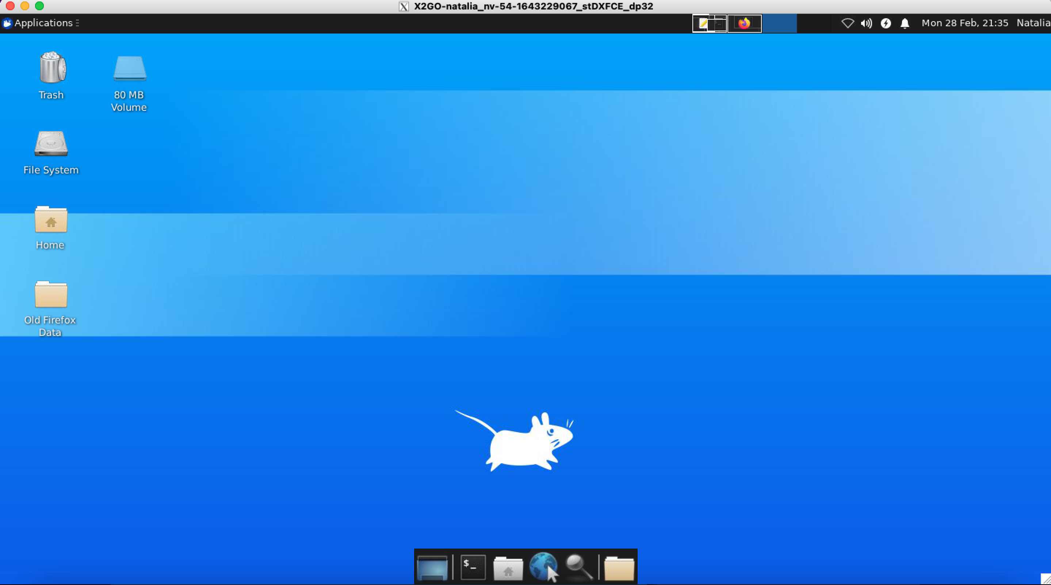
Homework
Download and install X2Go
Use the description on moodle in section “server” to log into the neurovision server
Once in the server environment, open the terminal and:
Try opening and closing MATLAB with a graphical interface
Try opening Freeview and loading FreeSurfer’s template subject “bert”

Slide 4
What you need
VPN to the University of Graz network
Cisco AnyConnect secure mobility client
Graphical Interface
All OS: X2Go
SSH (Command-line only)
OSX, Linux: Terminal
Windows: Putty
Description uploaded to moodle

Slide 5
T1-weighted MRI

Slide 6
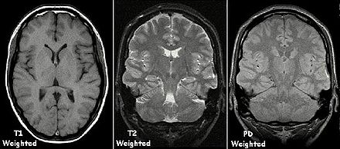
T1-weighted contrast
https://en.wikipedia.org/wiki/Magnetic_resonance_imaging

Slide 7
T1-weighted contrast
https://en.wikipedia.org/wiki/Magnetic_resonance_imaging

Slide 8
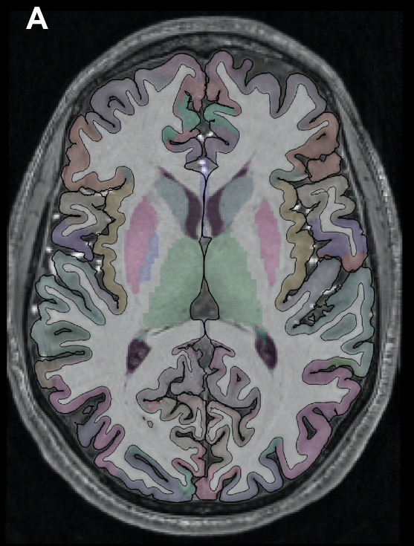
T1-weighted scans in cognitive and clinical neuroscience

Slide 9
What are they good for?

Slide 10
T1-weighted scans in cognitive and clinical neuroscience
Aging and neurodegeneration
Desease
Plasticity

Slide 11
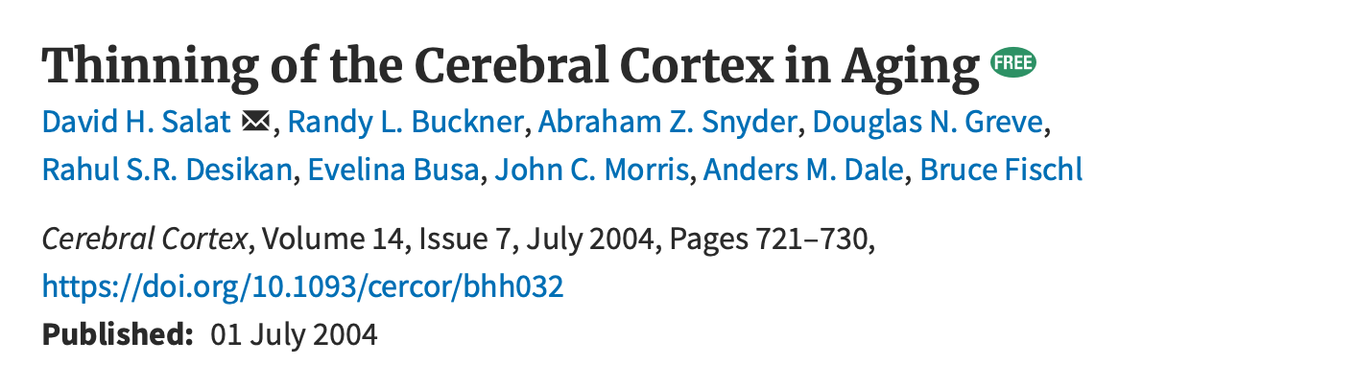
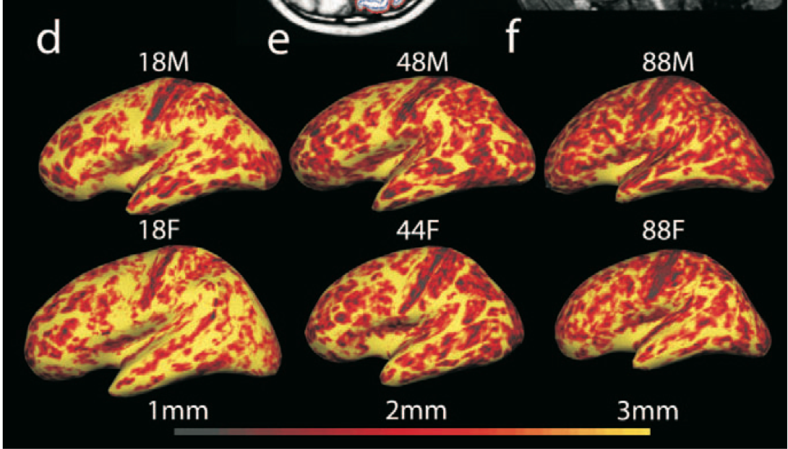

Slide 12
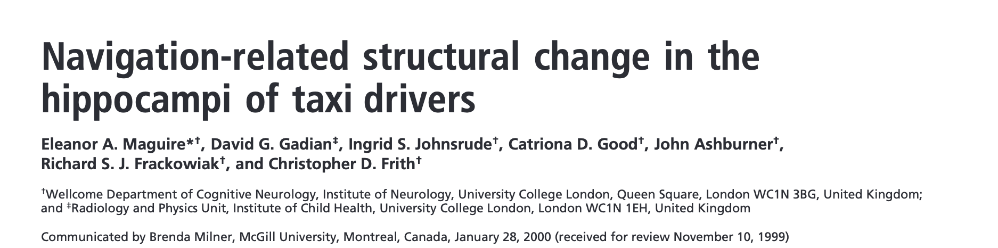
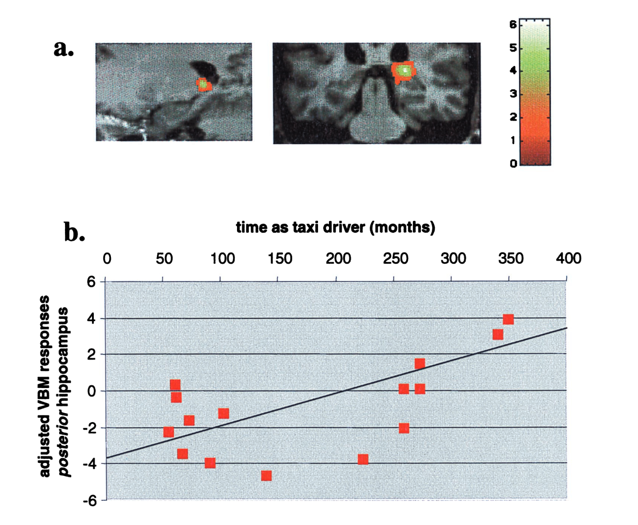

Slide 13
Project 1.1
Background

Slide 14
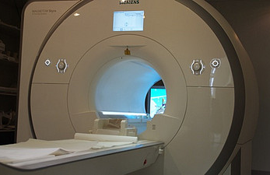
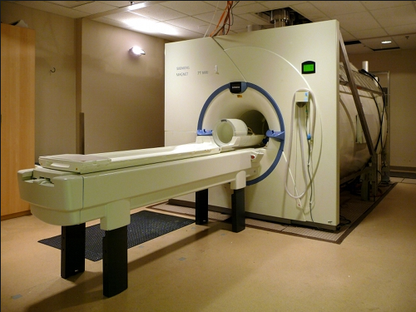
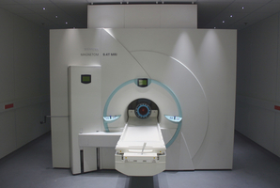
Advanced neuroimaging
3 Tesla
7 Tesla
9.4 Tesla
© University of Graz
© Center for Magnetic Resonance Research, Minneapolis, USA
© Max-Planck Institute for Biological Cybernetics, Tübingen
Notes:
The good thing is that modern imaging technology allows us to further push the resolution to the level of these fine-scale structures in the visual cortex.
The typical resolution of 3 tesla MRI scanners, such as the one we have in Graz, is around 3 mm.
However, scanners with higher magnetic field are becoming more and more popular, like the 7 or the 9.4 Tesla. And higher magnetic field allows to increase the spatial resolution to a submillimeter range.

Slide 15
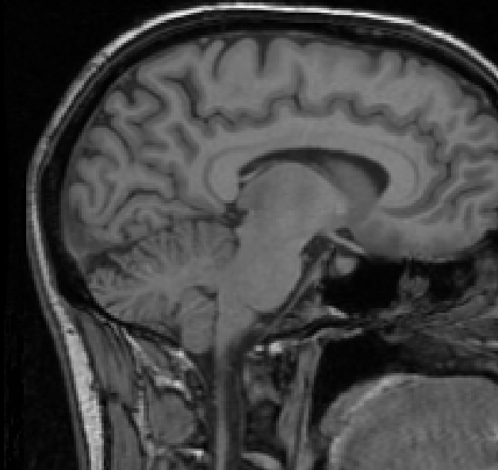
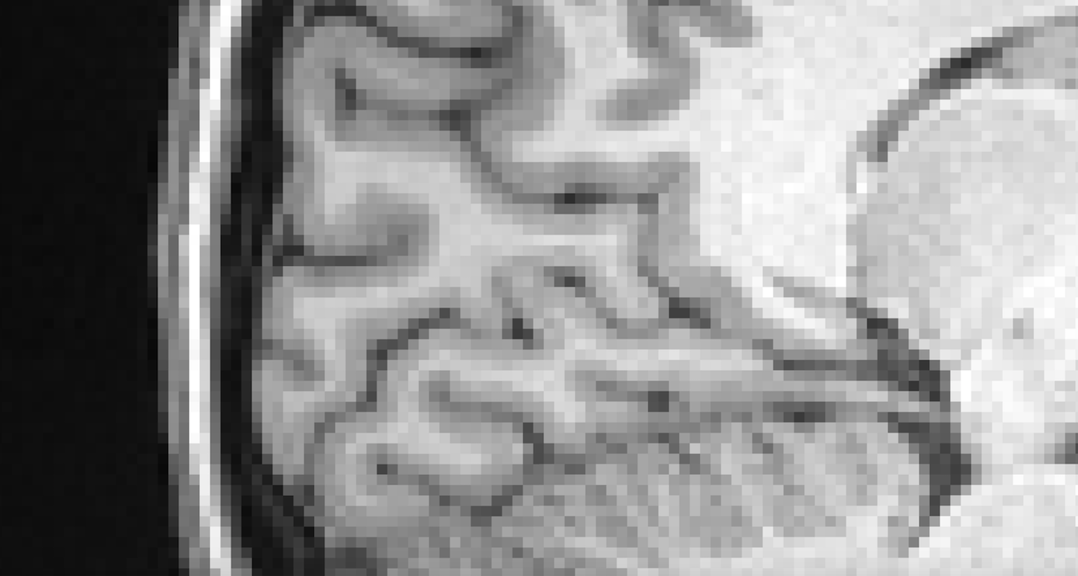
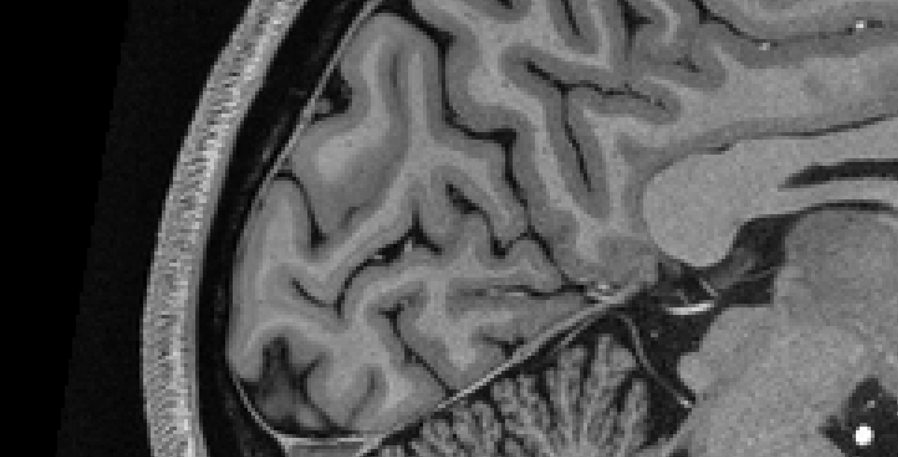
(1mm)³ resolution at 3T
(0.5mm)³ resolution at 7T
(c) Natalia Zaretskaya
Zaretskaya and Polimeni, in preparation
Zaretskaya and Polimeni, in preparation
Zaretskaya and Polimeni, in preparation
Notes:
First, it allows us to increase the resolution of the structural scans, as is illustrated here for the visual cortex.

Slide 16
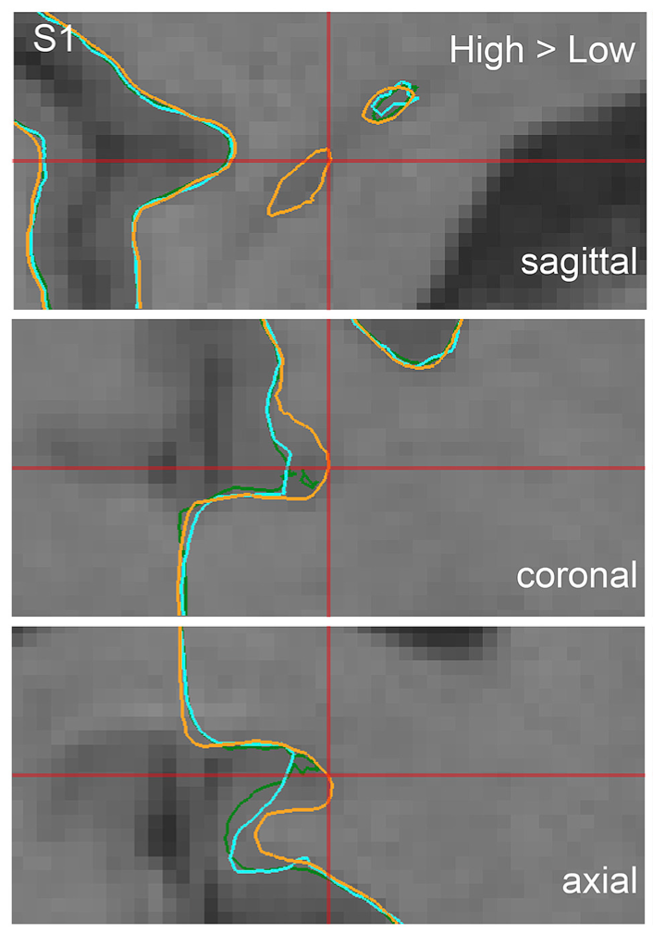
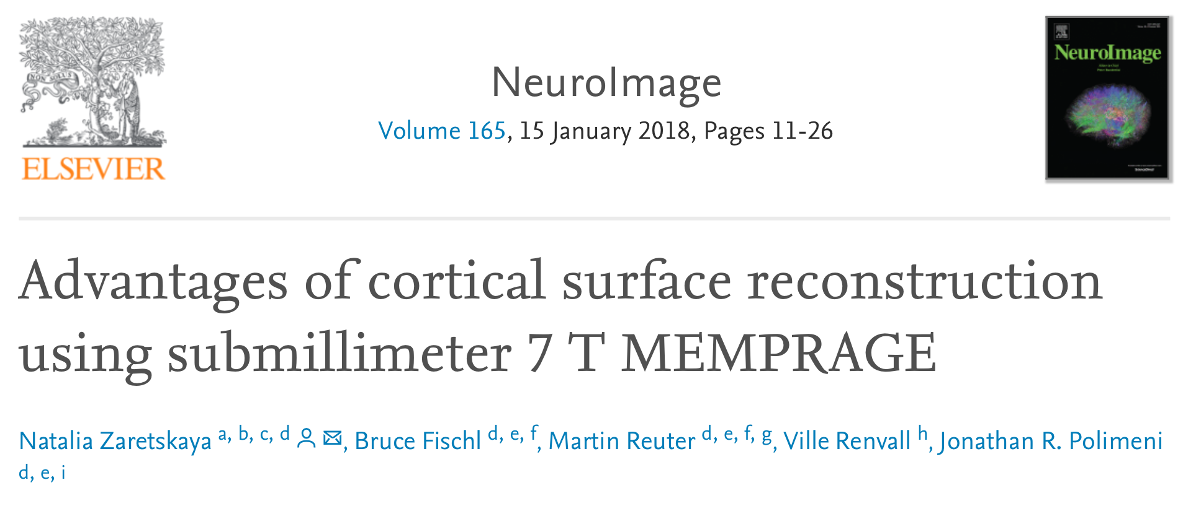
High resolution advantage

Slide 17
Accuracy vs. precision
What is the difference?

Slide 18
Accuracy vs. precision
Accuracy
Precision
How close the measurement is to ground truth
Relevant for accurately identifying neural structures
How reproducible the measurement is
Relevant for detecting statistically significant effects

Slide 19
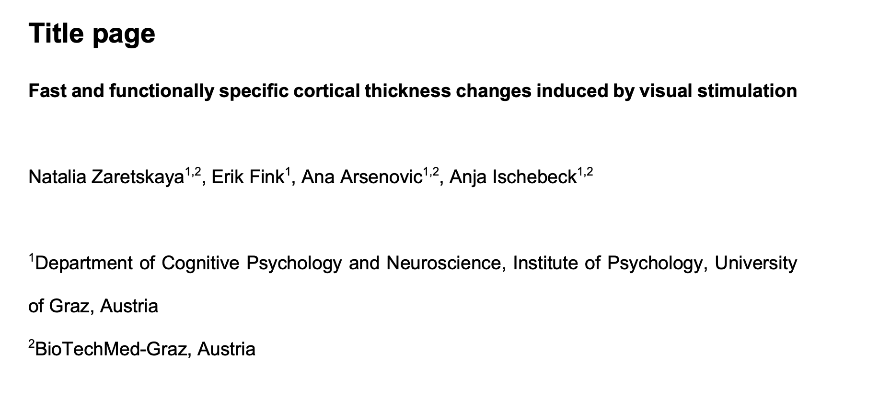
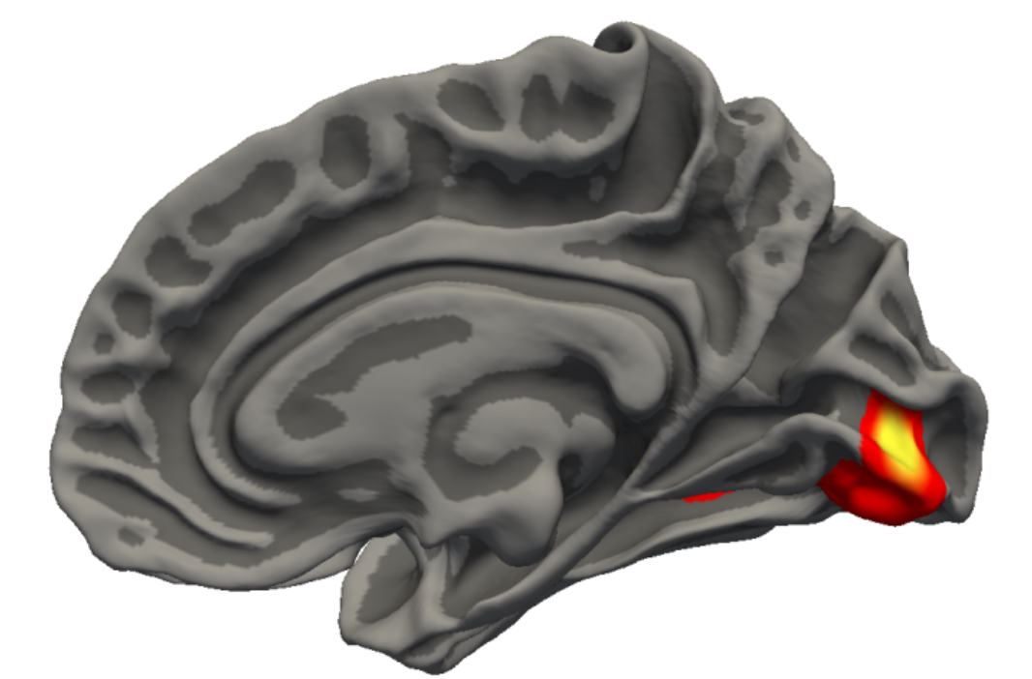
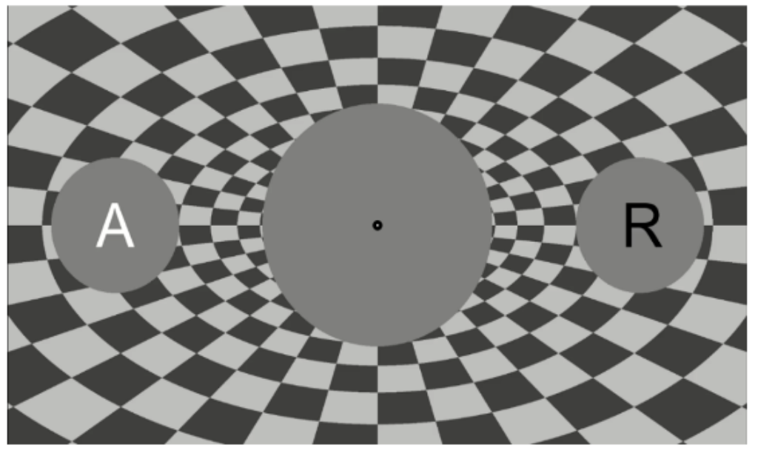
Project 1
Research question: Is there a precision advantage in high-resolution MRI

Slide 20
Project 1
Dataset
Your task for the presentation
Cortical thickness was analyzed using FreeSurfer’s longitudinal processing stream
Each participant was processed twice: once at 1 mm³ and once at 0.6 mm³
Checkerboard effect was only quantified for 1mm-processed data
Explain the experimental paradigm and the effects on cortical thickness found in the study at low resolution
Explain your research question
Make a suggestion on how you would compare the effects at low resoltuion and at high (“native”) resoltuion

Slide 21
Project 1.2
Background

Slide 22
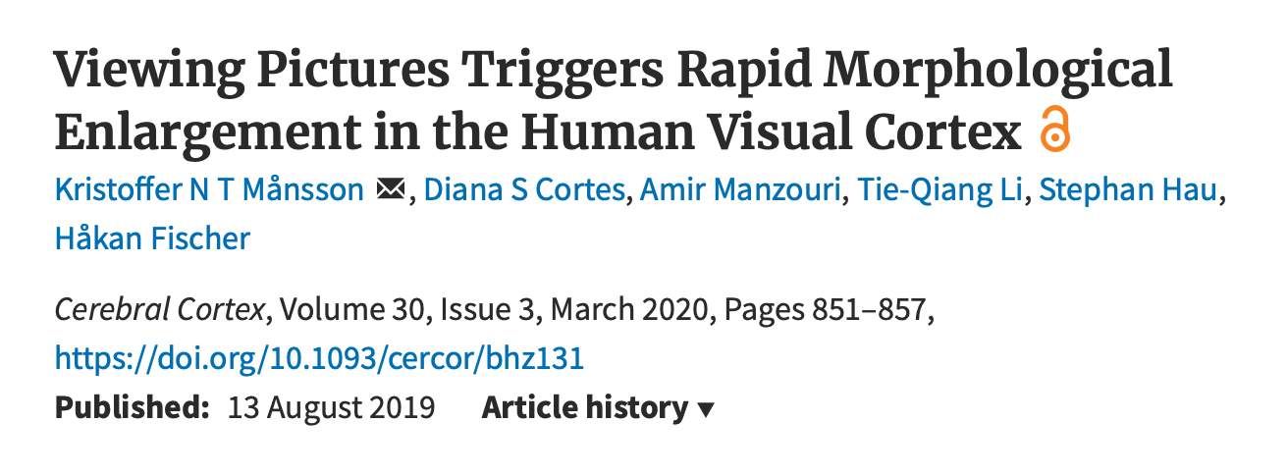
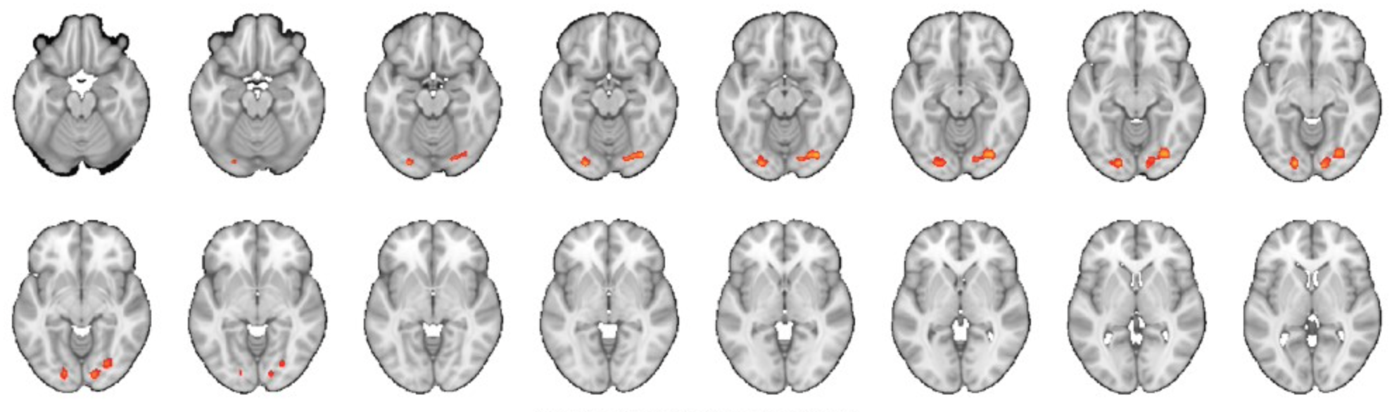

Slide 23
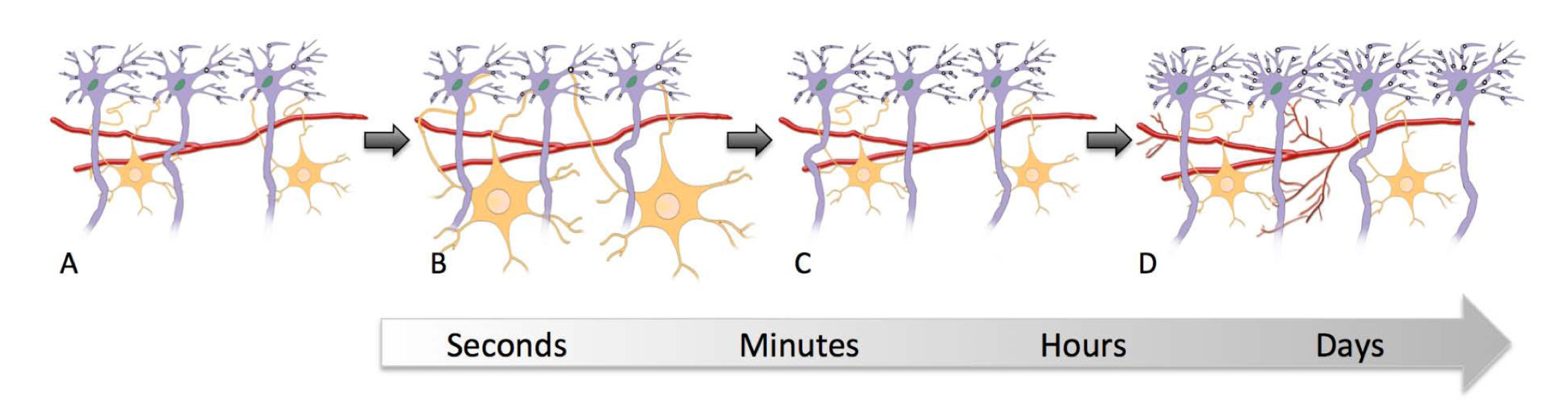
Mechanisms of fast structural changes
True structural effects of hemodynamics?

Slide 24
Project 2
Research question: visually indiced cortical thickness changes slow or fast

Slide 25
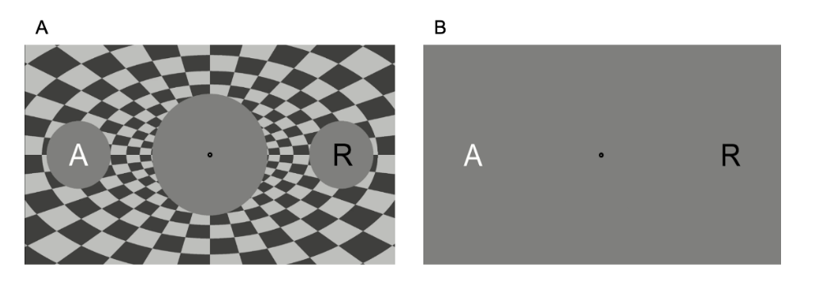
Experimental design
4 Runs per subject
Condition order randomized and counterbalanced

Slide 26
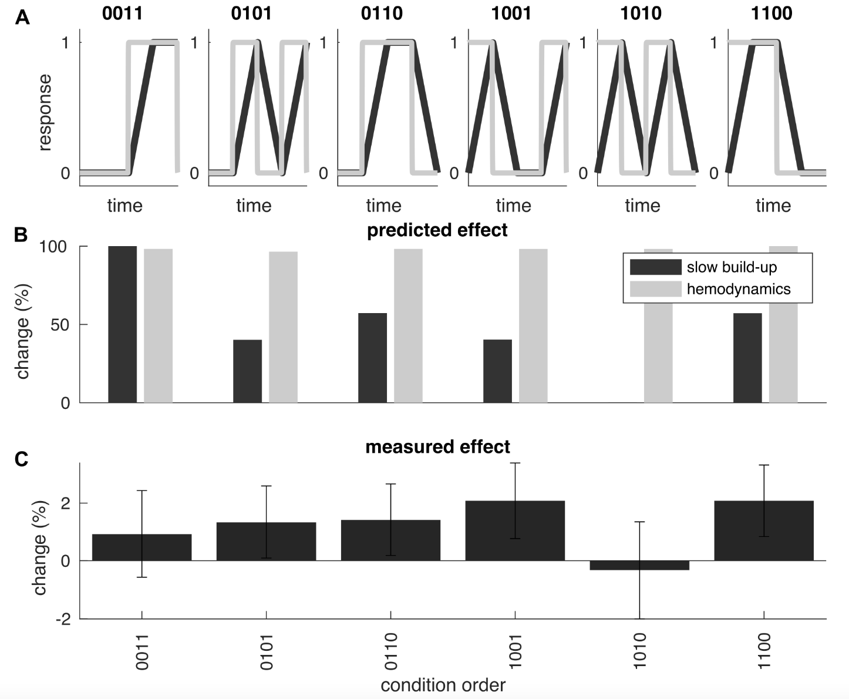
Fast or Slow?

Slide 27
Problem with the current data:
Too little data per subject, too little data per condition order, inter-individual variability

Slide 28
Project 2
Dataset
Your task for the presentation
Pilot dataset of 1 subject
Session 1:
Condition order 10101010
Session 2:
Condition order 00001111
explain the background
research question
experimental paradigm
hypotheses
statistical tests, dependent and independent variables

Slide 29
Project 1.3
Background

Slide 30
Advanced neuroimaging
3 Tesla
7 Tesla
9.4 Tesla
© University of Graz
© Center for Magnetic Resonance Research, Minneapolis, USA
© Max-Planck Institute for Biological Cybernetics, Tübingen
Notes:
The good thing is that modern imaging technology allows us to further push the resolution to the level of these fine-scale structures in the visual cortex.
The typical resolution of 3 tesla MRI scanners, such as the one we have in Graz, is around 3 mm.
However, scanners with higher magnetic field are becoming more and more popular, like the 7 or the 9.4 Tesla. And higher magnetic field allows to increase the spatial resolution to a submillimeter range.

Slide 31
(1mm)³ resolution at 3T
(0.5mm)³ resolution at 7T
(c) Natalia Zaretskaya
Zaretskaya and Polimeni, in preparation
Zaretskaya and Polimeni, in preparation
Zaretskaya and Polimeni, in preparation
Notes:
First, it allows us to increase the resolution of the structural scans, as is illustrated here for the visual cortex.

Slide 32
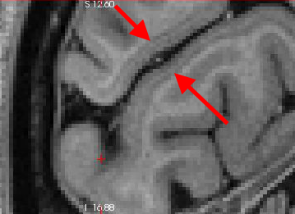
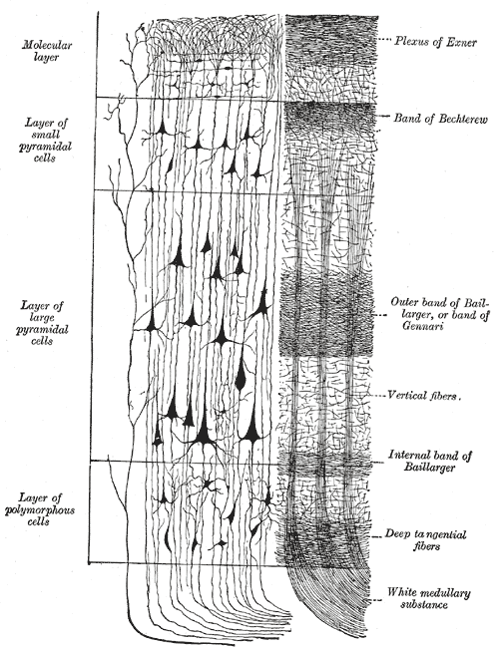
(0.5mm)³ resolution at 7T
Gray, 1918
Notes:
This is the stria of Gennari, the highly myelinated layer 4 of the primary visual cortex.

Slide 33
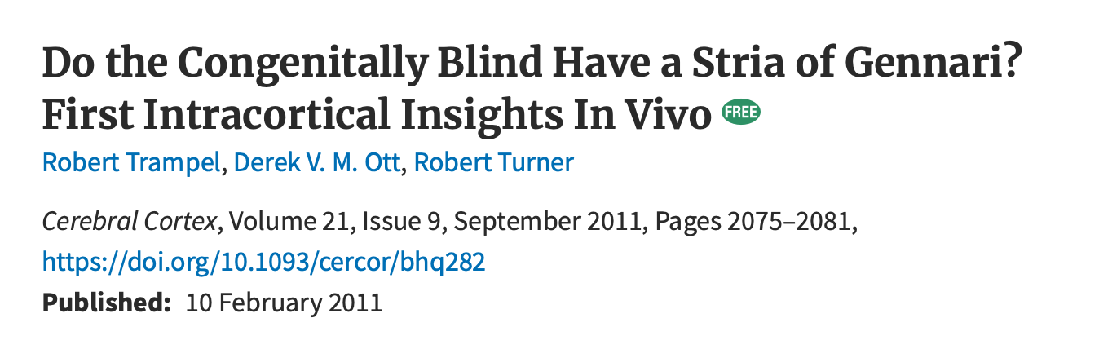

Slide 34
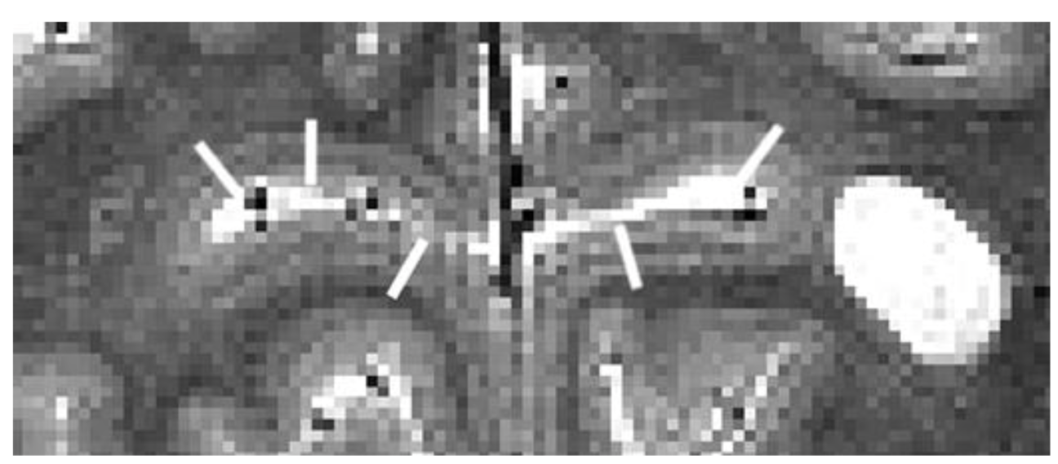

Slide 35
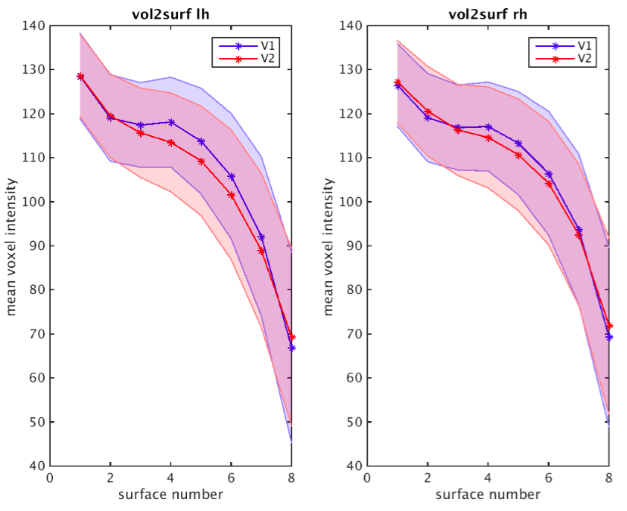
Stria signal can be automatically detected in T1w MRI

Slide 36
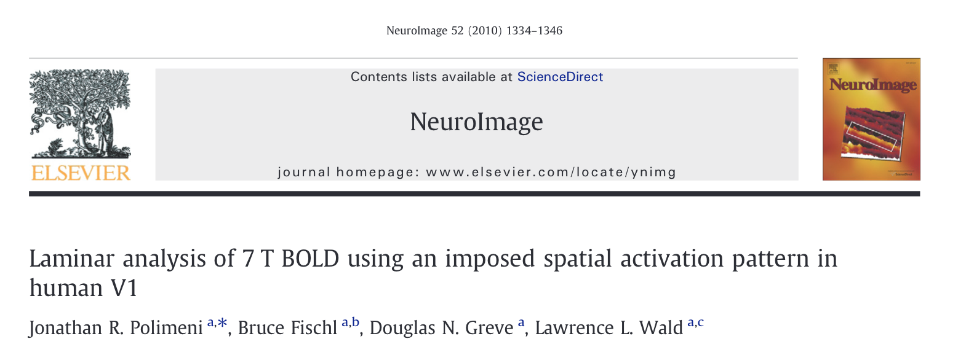
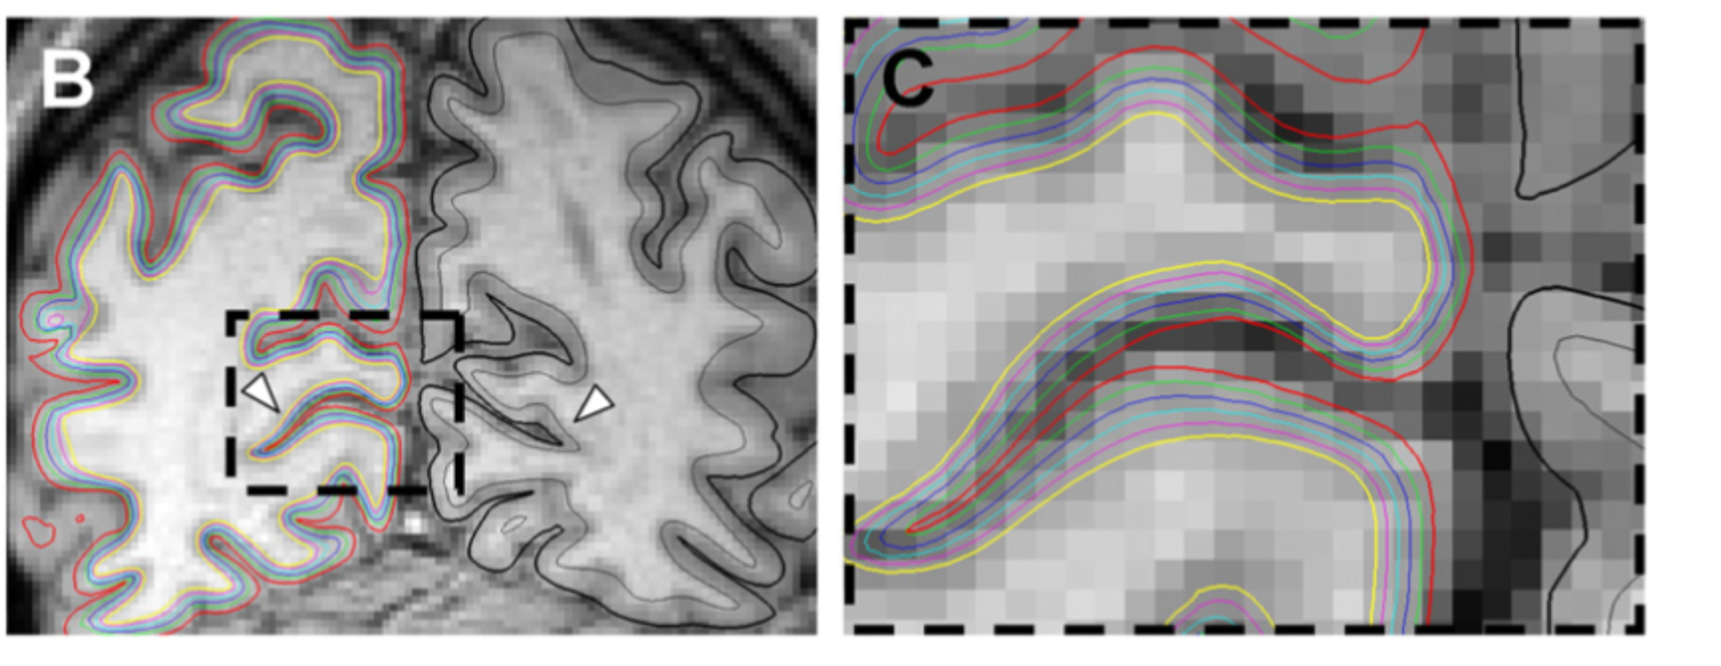
How?

Slide 37
7 T MRI data with 0.5 mm resolution

Slide 38
Project 1.3
Research question: can we detect stria signal it in a high-resolution 3 T scan?

Slide 39
Project 1.3
Dataset
For the presentation
Same dataset as 1.1, but checkerboard stimulaiton is irrelevant
All four scans are aligned, averaged and analyzed as one
We will need to generate intermediate surfaces and do the voxel intensity sampling
Explain the background
Research question
Statistical tests, dependent and independent variables

